Slide 1

The Machine Module
Lesson 22

Slide 2
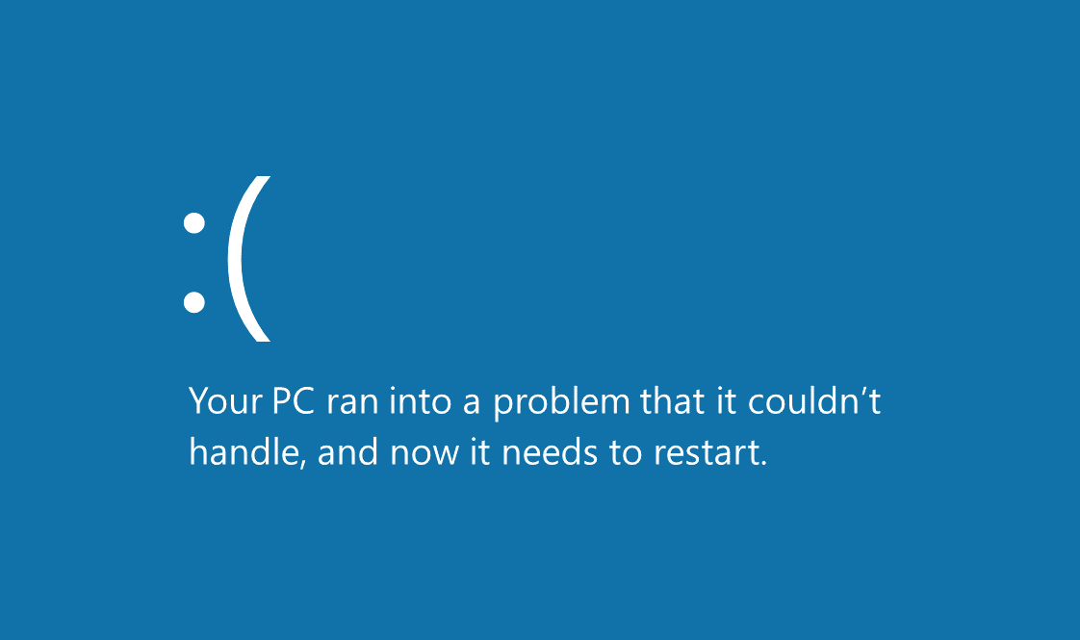
Blue screen of death
Notes:
Display and start the lesson with a discussion about error messages

Slide 3
What the Lesson Will Cover
Know what the machine module is
Demonstrate a use of some of the features
Adapt the features to use in programs

Slide 4
What Is the Machine Module?
The micro:bit machine module contains a number of functions related to the micro:bit hardware
The module allows you access to the restricted hardware such as the CPU, timers, buses, etc
Be aware that if used incorrectly they can lead to malfunction, lockups, crashes of your board, and in extreme cases, hardware damage
Notes:
Discuss the machine module, ask Learners what a module is
Explain that the machine module can damage the micro:bit if used incorrectly

Slide 5

Kernel Panic
The kernel is a key part of an operating system that loads and remains in the memory of the computer
If an error occurs it goes into a panic, which usually means that it displays some sort of error message
This error message can be used to look up what the issue is and how to resolve it
Notes:
Ask Learners how a computer knows something is wrong it not working correctly
Explain the role of the kernel

Slide 6

Unique ID
Every micro:bit has its own unique ID number which is used to distinguish it from other micro:bits
There are several hundred thousand micro:bits all over the world each with their own unique ID number
You can use the machine module to return the ID number as a byte string
This is a combination of letters, number symbols
This Photo by Unknown Author is licensed under CC BY-SA
Notes:
Explain about ID numbers, perhaps could give examples of other uses of ID numbers, (gamer tags, health records)

Slide 7
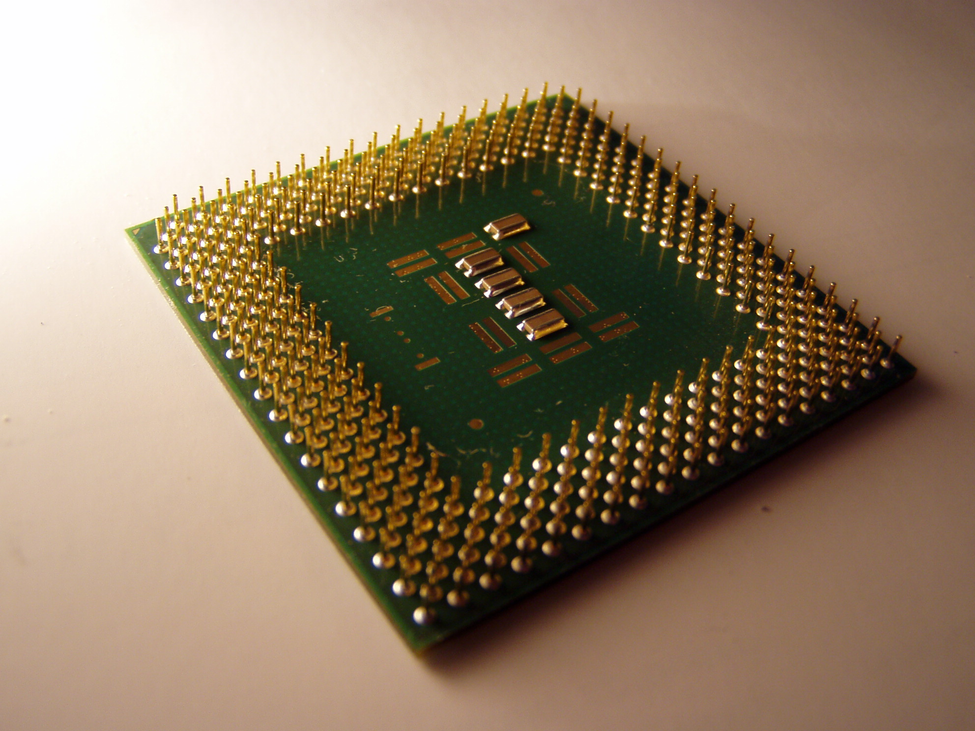
The CPU
The central processing unit (CPU) is like the brain of each micro:bit
It is responsible for processing all the program instructions and then responding
For example, when you press Button A, the smiley face is displayed on the LED matrix – this is controlled by the CPU
It is possible to return the frequency that the CPU is running at
This is measured in Hertz (Hz)
The higher the frequency the more work the CPU is carrying out
This Photo by Unknown Author is licensed under CC BY-SA
Notes:
Explain about the CPU and its role
Learners could make a list of all the devices that use a CPU

Slide 8
Running Time
The machine module can keep track of how long the micro:bit has been running for
It returns the number of milliseconds since the board was switched on or restarted (reset)
The time is measured in milliseconds which are 1000th of a second
For example, 1 second is 1000 milliseconds, 2 seconds are 2000
Notes:
Recap that time is measured in milliseconds, so 1000 is 1 second

